Slide 1


Bapuji Institute Of Engineering & Technology Davanagere, Karnataka-577004.
DEPARTMENT OF COMPUTER SCIENCE & ENGINEERING
FINAL YEAR PROJECT PRESENTATION
ON
“IOT Approach For Anti-Plundering:Halting the Erasure of
Endangered Trees”
PROJECT GUIDES
DR. ABDUL RAZAK M S
Associate Professor
BIET ,DAVANAGERE
Prof. SWETHA H U
Assistant Professor
BIET, DAVANAGERE
PROJECT ASSOCIATES
JEEVAN H K 4BD20CS040
MANASVI G M 4BD20CS050
NEHA M RAIKAR 4BD20CS061
NISHITHA A N 4BD20CS063
HEAD OF DEPARTMENT
DR.NIRMALA C R
PROF. & HEAD OF
DEPARTMENT
CS&E

Slide 2
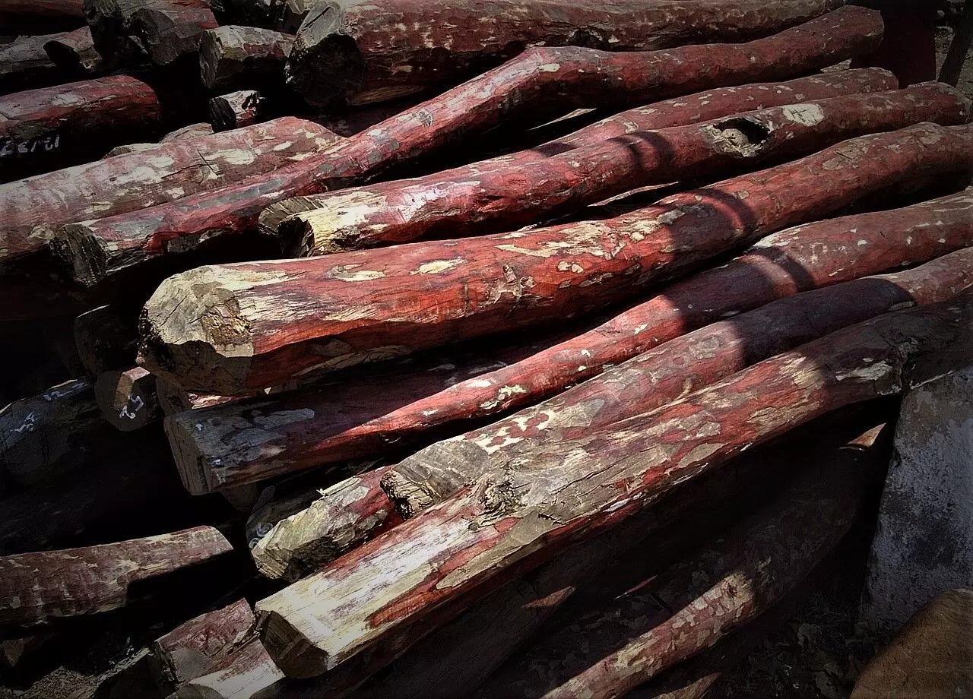
PROJECT TITLE:
ANTI-PLUNDERING:HALTING THE ERASURE OF ENDANGERED TREES

Slide 3
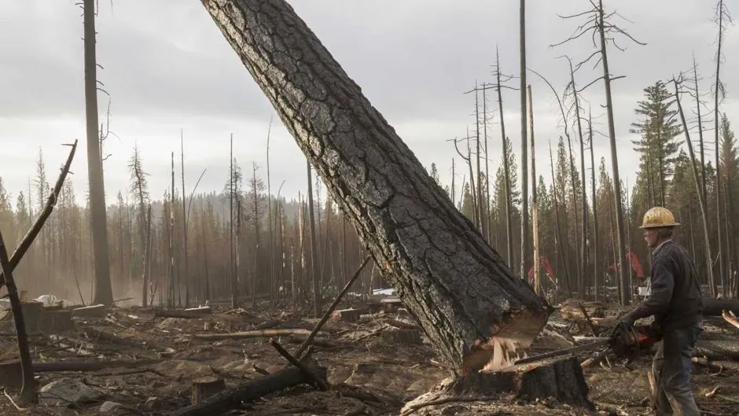
CONTENTS
Abstract
Introduction
Summary of literature survey
Existing system
Problem statement
Proposed system
Objectives
System requirements
System architecture
Methodology
Results
Conclusion
Future scope

Slide 4
ABSTRACT
Smuggling of the most important trees such as sandal wood in forests, poses a serious threat to forest resources, causes significant economic damage and ultimately has quite a devastating effect on the environment all over the world. We propose a microcontroller based antipoaching system employing WSN technology, which is capable of detecting theft by monitoring the vibrations produced by the cutting of trees/branches using a 3 axis MEMS accelerometer. A microcontroller is used along with mobile so that the information can be uploaded. WSN is widely used technology in remote monitoring applications. The embedded system architecture and the hardware/software designs are described in detail. Vibration data collected by various tests on wood and simulated using Arduino IDE.

Slide 5
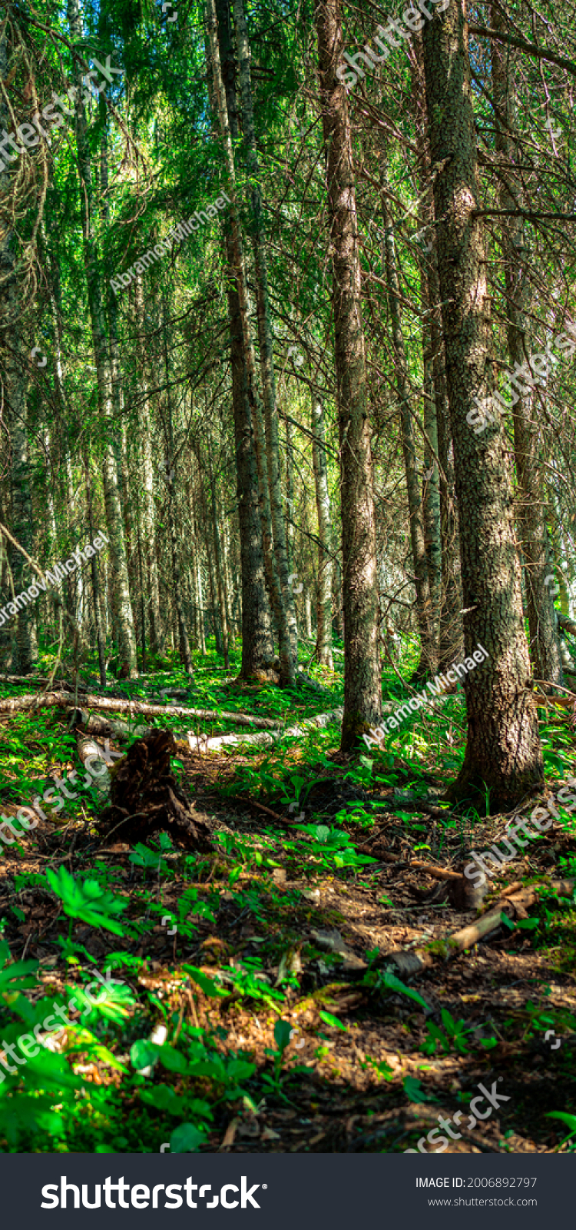
INTRODUCTION
In recent years poaching or smuggling of environmentally and economically important species of trees in forested areas- such as Sandalwood, Teakwood, Pine and Rosewood has been tremendously increased. There have been several initiatives undertaken by different stakeholders– and in particular by the Govt. of India, to mitigate these problems.
The main goal of our project is to design and develop a product which is portable wireless sensor node which is a part of wireless sensor Network. It will be mounted on trunk of each tree, capable of detecting theft as well as automatically initiate send alarm signals if any to remote terminal through wireless media.

Slide 6
LITERATURE SURVEY
Year | Title | Authors | Remarks
2021 | Techniques used for ANTIPOACHING OF TREES | Chinmaye Reddy D, Bhuvana N | Identifies the limitations of existing surveillance systems and introduces the potential of IoT-based Wireless Sensor Networks as a technological solution.
2020 | IoT based Anti- Poaching Alarm System for Valuable Trees | Pooja Baraddi, Ritika Jadhav | Provides a detailed explanation of key sensors such as the accelerometer, ultrasonic sensor, pH sensor, and fire sensor, demonstrating a comprehensive understanding of the technology employed.
2019 | Anti-poaching alarm system for tree in forest | Prof.Dr.M.C.Hingane, Vandana Datta Ingale | Proposes a sophisticated system incorporating tilt, temperature, and sound sensors, along with a relay switch and an Android application
2018 | IOT Based Anti-Poaching of Trees and Protection of Forest | Vishal S, Roshini Sultana | Underscores the necessity for proactive measures to counteract this issue, leveraging the capabilities of Internet of Things (IoT) technology.

Slide 7
EXISTING SYSTEM
The existing system consists of Camera Surveillance, Satellite Monitoring, Drones, IoT based Anti-poaching alarm system.
DRAWBACKS:
Setting up cameras in vulnerable areas to monitor and capture activities, but this may be limited by the camera’s field of view and the need for regular maintenance.
Utilizing satellite imagery for large-scale monitoring, although this can be expensive and might not provide real-time data.
Employing unmanned aerial vehicles for aerial surveillance, offering flexibility and real-time monitoring but with limitations in terms of battery life and coverage.
Involves real time alarm system whenever poaching is about to be done but, this model doesn’t provide real time location of the tree.

Slide 8
PROBLEM STATEMENT
Poaching and illegal logging are hurting special trees. This harms nature, messes up the environment, and makes rare trees disappear. The illegal trade also causes deforestation, making the global environmental problem worse. Losing these trees not only hurts nature but also stops scientists from finding new medicines. We need to act fast to protect these important trees and save our planet

Slide 9
PROPOSED SYSTEM
The portable wireless sensor model consists of two modules one involving sensors and controller module which will be at tree spot and another one is Android phone.
We have built an application which will continuously receive sensor data. We upload sensor data continuously to mobile. Accelerometer sensor is used to determine whether the tree is cut down or not similarly, temperature sensor is used to determine whether the tree is on fire or not.
Using Blynk application, alert will be sent in smuggling case. We can monitor and control by using GSM Technology which will convey the message from monitor station to the control station vice versa using wireless technology. By using GPS, we can get a real time Location.

Slide 10
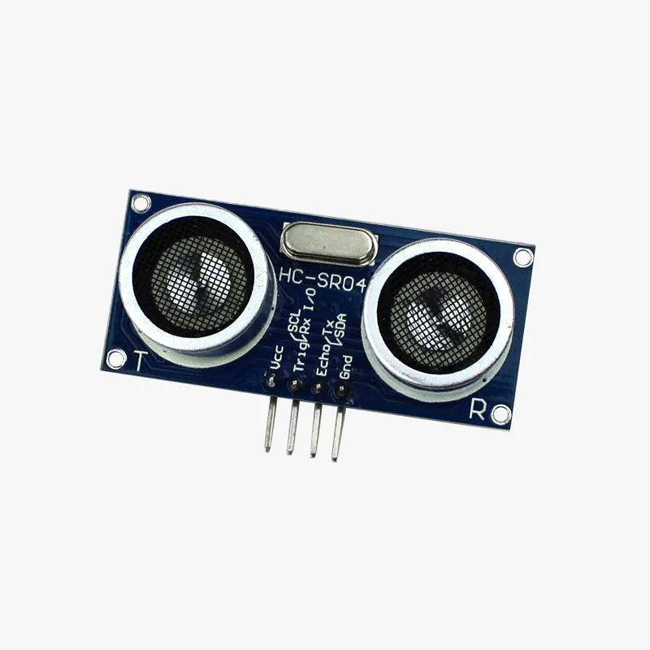
OBJECTIVES
To design a portable wireless sensor device consisting of sensor modules and a controller module, which will be placed at the tree spot, and monitoring done through Android phone.
To notify an alarm system using an accelerometer sensor, temperature sensor, LCD, LED, buzzer, and to activate the alarm during emergencies.
To develop a system that monitors and is controlled using GSM technology, conveying messages between the monitoring system and the control system in both directions.
To monitor and capture the activities by obtaining the real time to monitor location by using GPS.

Slide 11
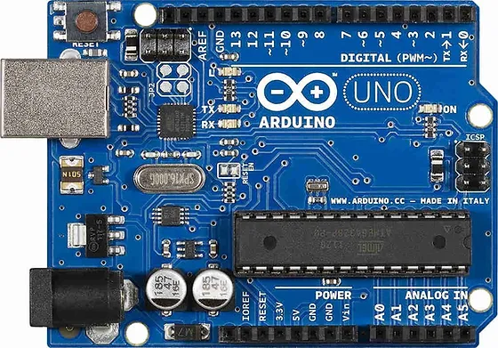
SYSTEM REQUIREMENTS
Software Requirements
Arduino IDE
Blynk Application
Operating Systems supported
Windows 10
Technologies and languages used to develop
Embedded C

Slide 12
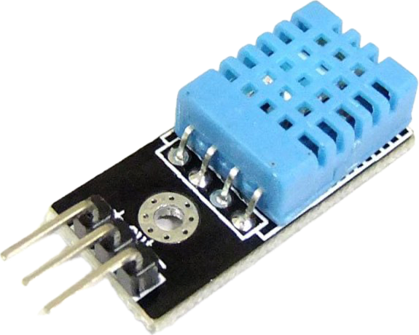
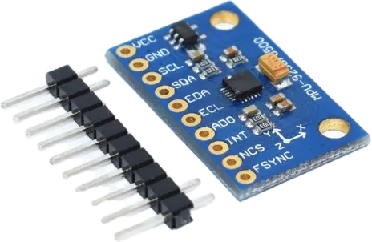
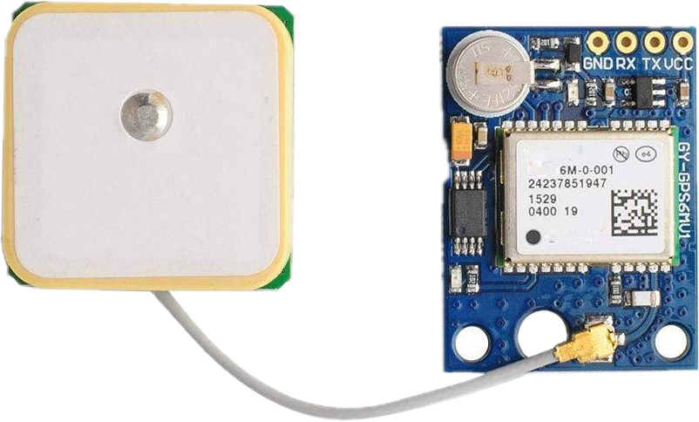
SYSTEM REQUIREMENTS
Hardware Requirements
Arduino UNO
Node MCU
PCB
12V Adapter
Buzzer
Sensors : DHT11 Temperature sensor, Accelerometer sensor, Ultrasonic sensor
NEO-6M GPS module

Slide 13
SYSTEM ARCHITECTURE
LCD
ULTRASONIC SENSOR
ARDUINO UNO
ESP8266
NODE MCU
TEMP SENSOR
BLYNK 2.0
ACCELEROMETER SENSOR
BUZZER
GPS
POWER SUPPLY
Fig 1: Block Diagram of Anti-Plundering system

Slide 14
SYSTEM ARCHITECTURE
Sensors: Various types of sensors such as motion sensors, temperature sensors, etc., are deployed strategically in the area prone to plundering. These sensors will detect any unusual activities or movements.
IoT Devices: The sensors are connected to IoT devices. These devices will collect data from the sensors, give alerts and transmit it to the Blynk app.
Connectivity: Suitable connectivity options such as Wi-Fi, cellular are used to connect the IoT devices to the Blynk application.
Alerts and Notifications: The system is configured to generate alerts and notifications whenever suspicious activities are detected. These alerts are be sent to security personnel via email through a dedicated application.

Slide 15
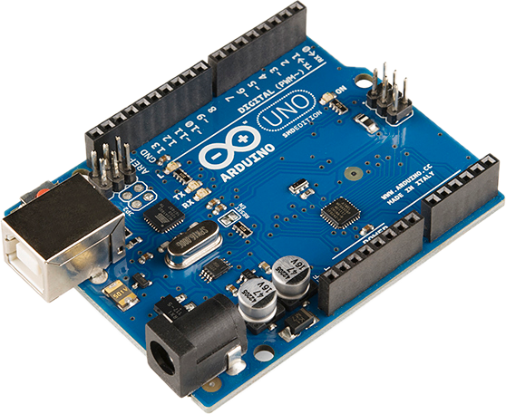

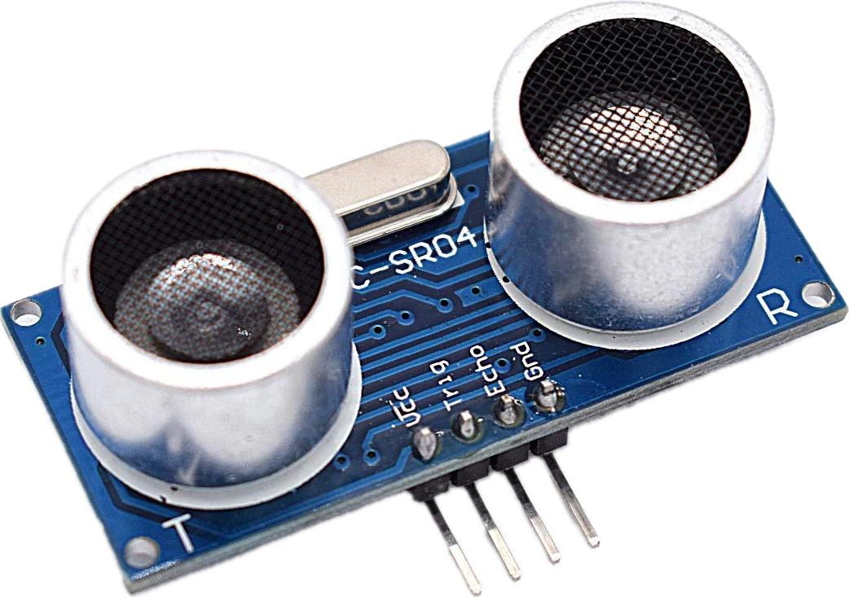
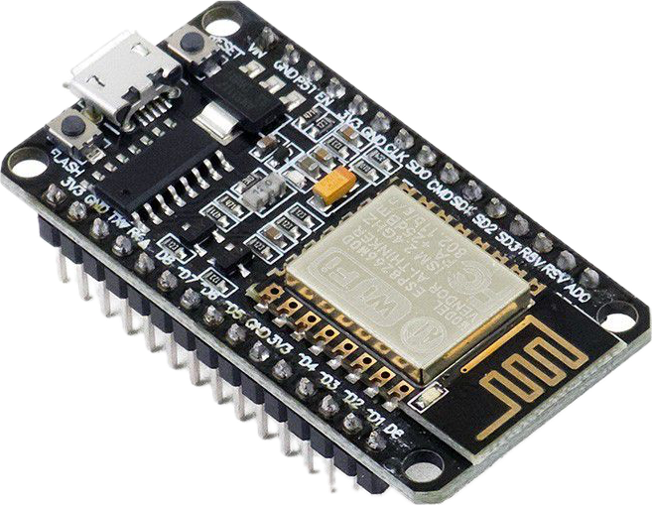
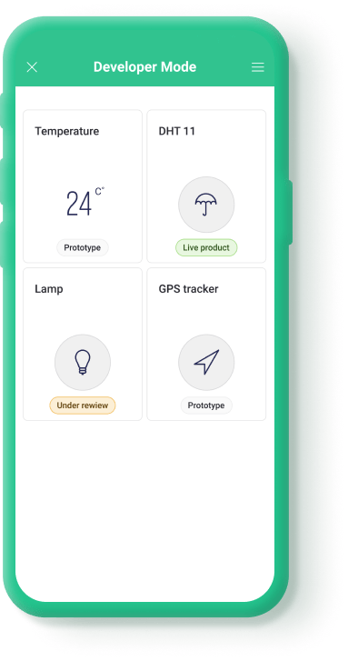

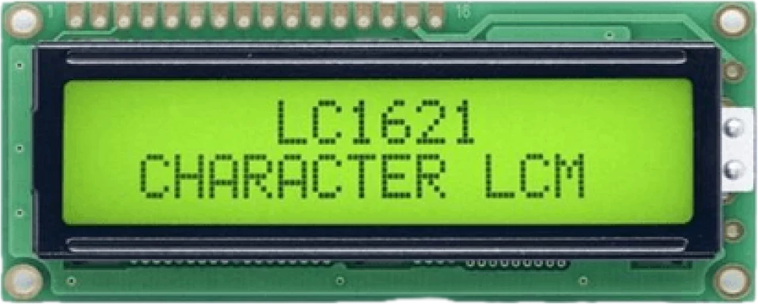

METHODOLOGY
Threshold computation
MEDIUM
Input devices(sensors)
LCD and Buzzer
Data
Reads GPS values
Transfer
Output device(blynk application)
Transmission
Fig 2 : Working flow of Anti-Plundering System

Slide 16
METHODOLOGY
The methodology encompasses a multifaceted approach, utilizing a combination of hardware components and advanced technologies.
The holistic nature of this system allows for comprehensive surveillance, ensuring the safety of endangered trees.
The Arduino UNO serves as the brain of the operation, orchestrating data collection and processing from the Ultrasonic sensor, MPU 6050 accelerometer, LCD, and DHT11 sensor.
The Ultrasonic sensor is strategically employed for proximity-based theft detection, while the MPU 6050 accelerometer detects abnormal vibrations or movements that may indicate unauthorized activity.
The DHT11 sensor monitors the environmental conditions around the tree, adding an additional layer of protection by triggering alerts for unfavorable changes in temperature or humidity.

Slide 17
METHODOLOGY
The Node MCU ESP8266 facilitates wireless communication, enabling real-time data transmission to the Android app.
To enhance on-site security, an LCD and Buzzer system has been incorporated, serving as immediate visual and audible alerts in response to potential threats.
Blynk application, complements the hardware system by providing users with remote control and monitoring capabilities.
Additionally, the app incorporates a tracking facility, allowing users to monitor the location of the protected trees in real-time.
This adds a layer of transparency and accountability to the system, enabling efficient response to incidents.

Slide 18
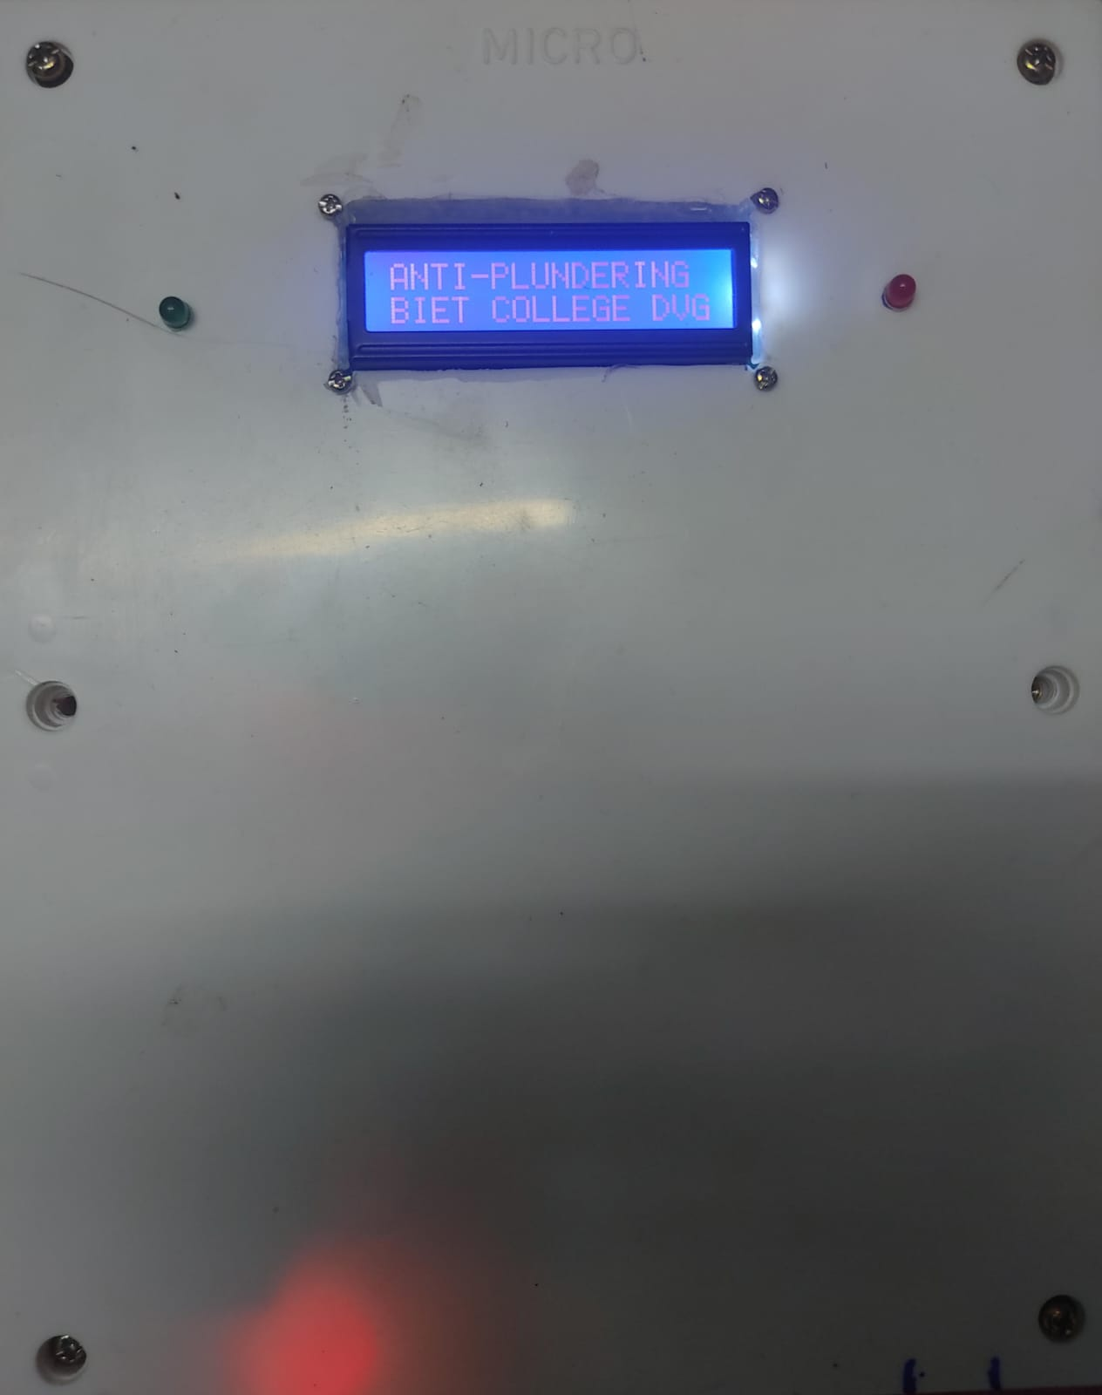
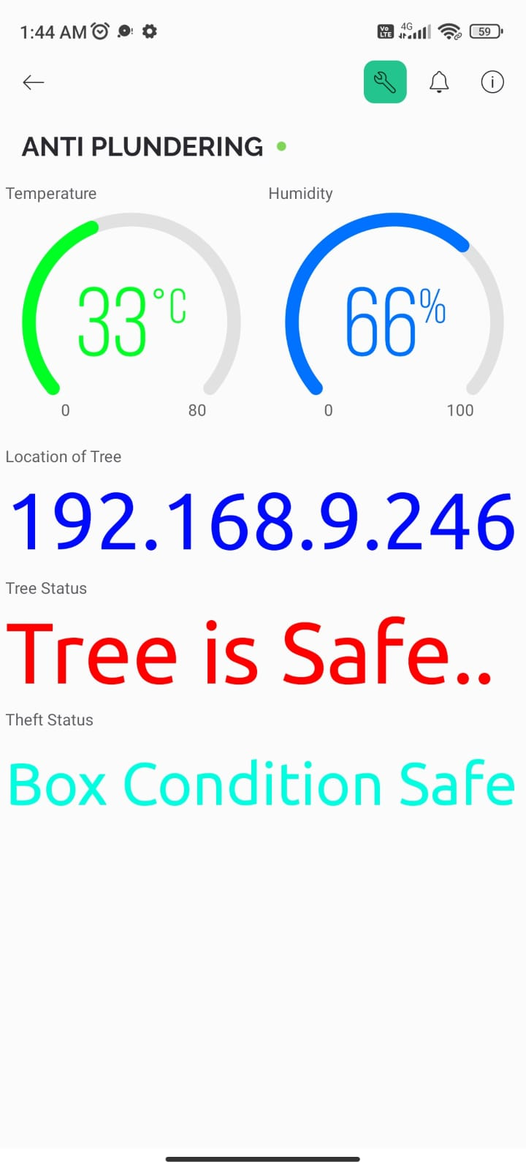
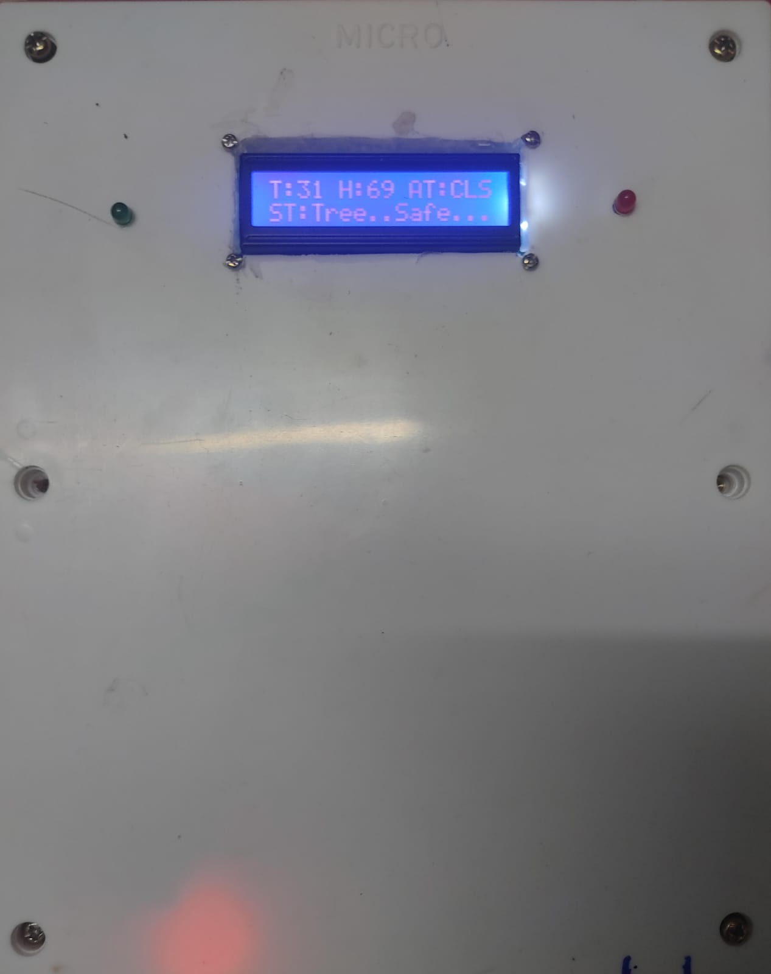
RESULTS
Fig 3 : Live data in Anti-Plundering Model and Blynk application

Slide 19
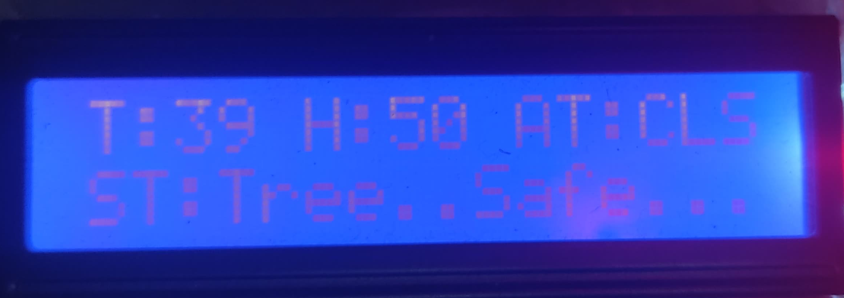
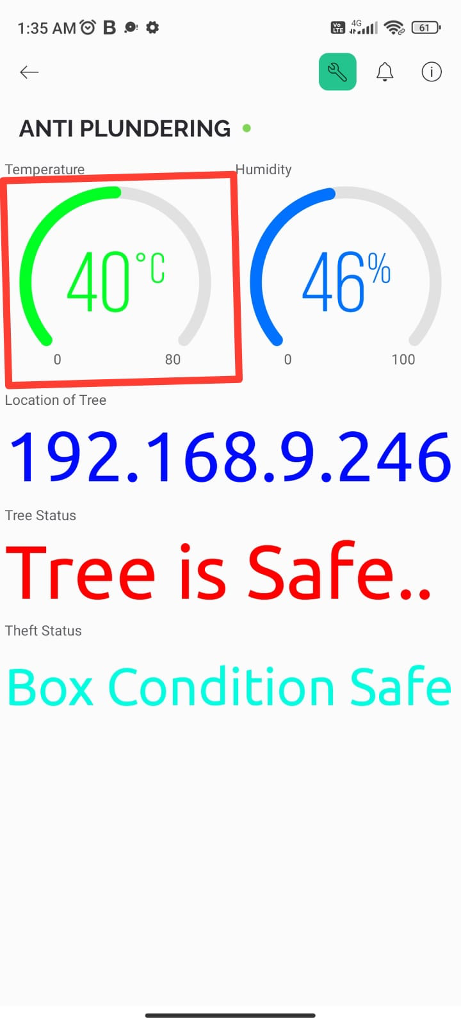
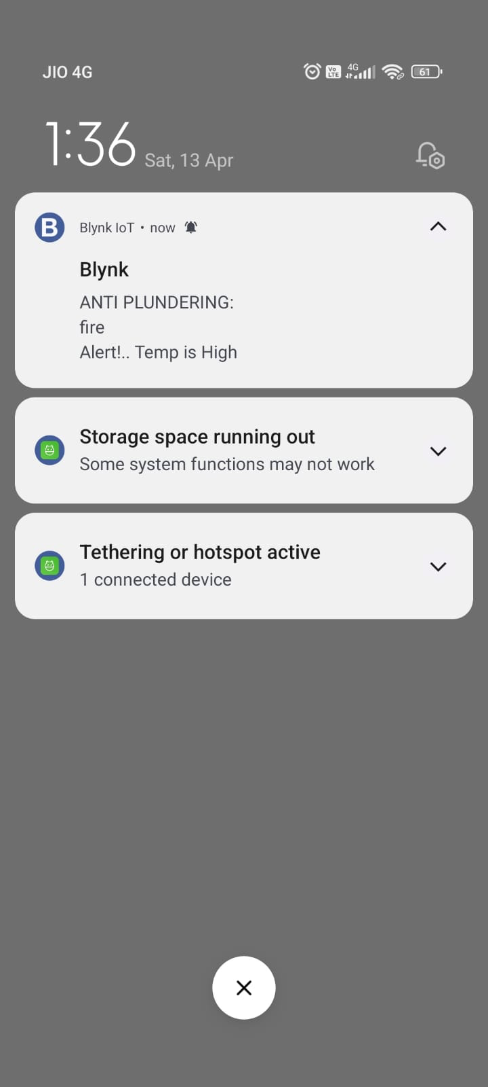
FIRE ALERT:
Fig 4 : Alert for high temperature

Slide 20
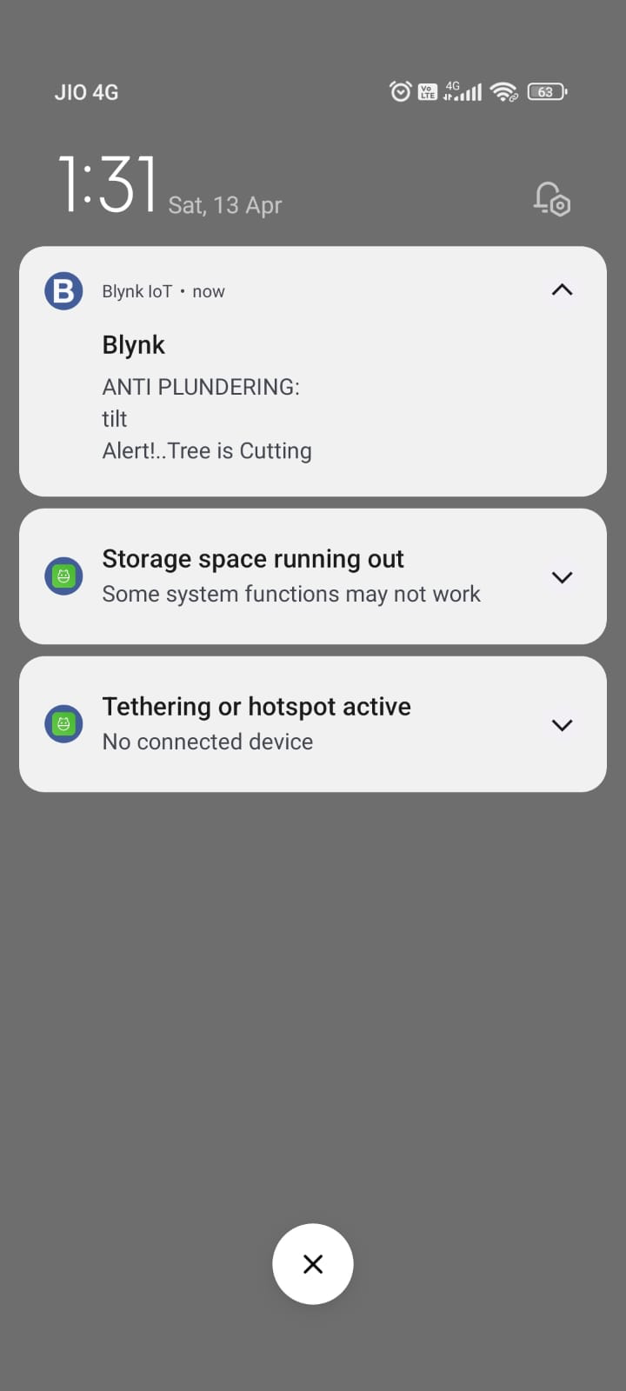
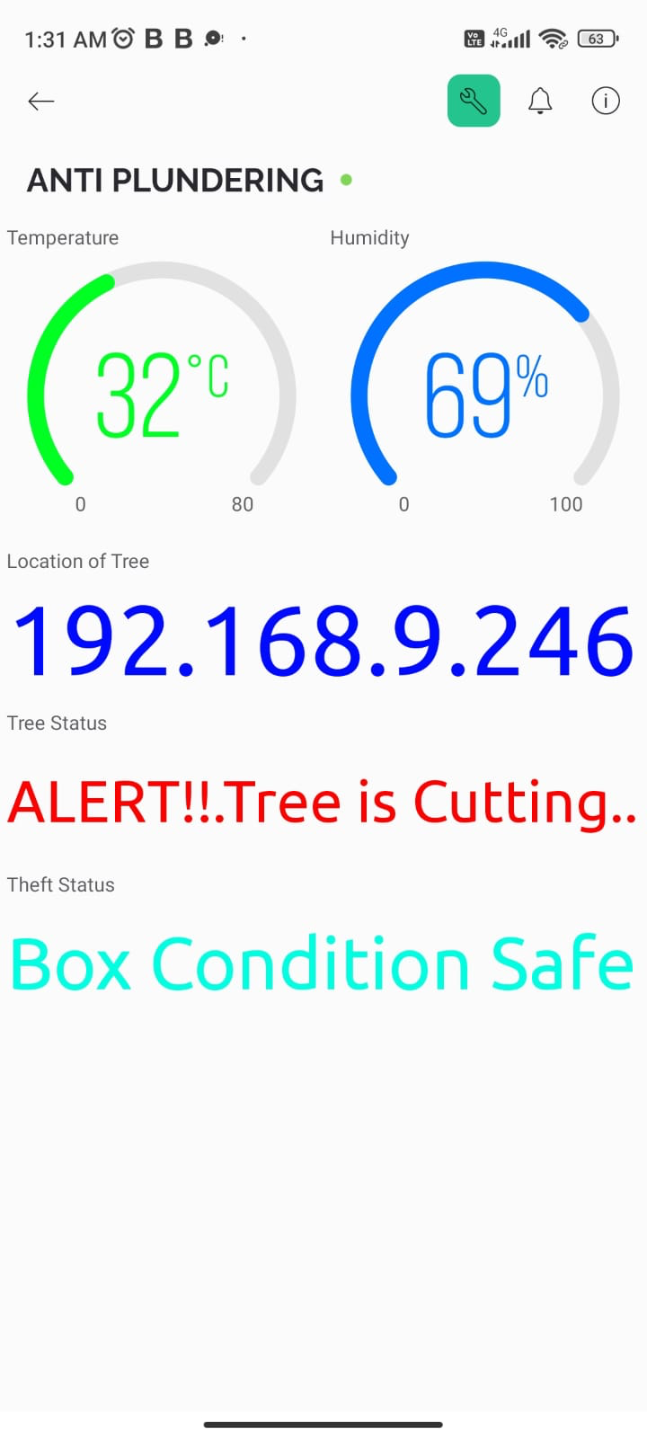
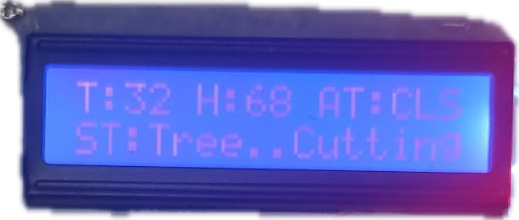
TREE CUTTING:
Fig 3 : Alert for tree tilting

Slide 21

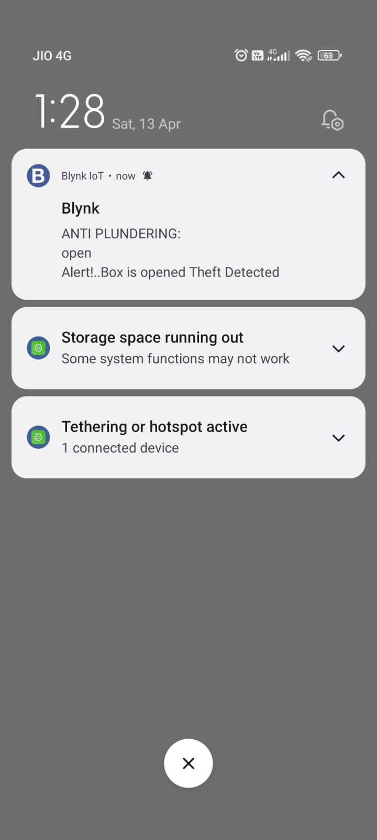
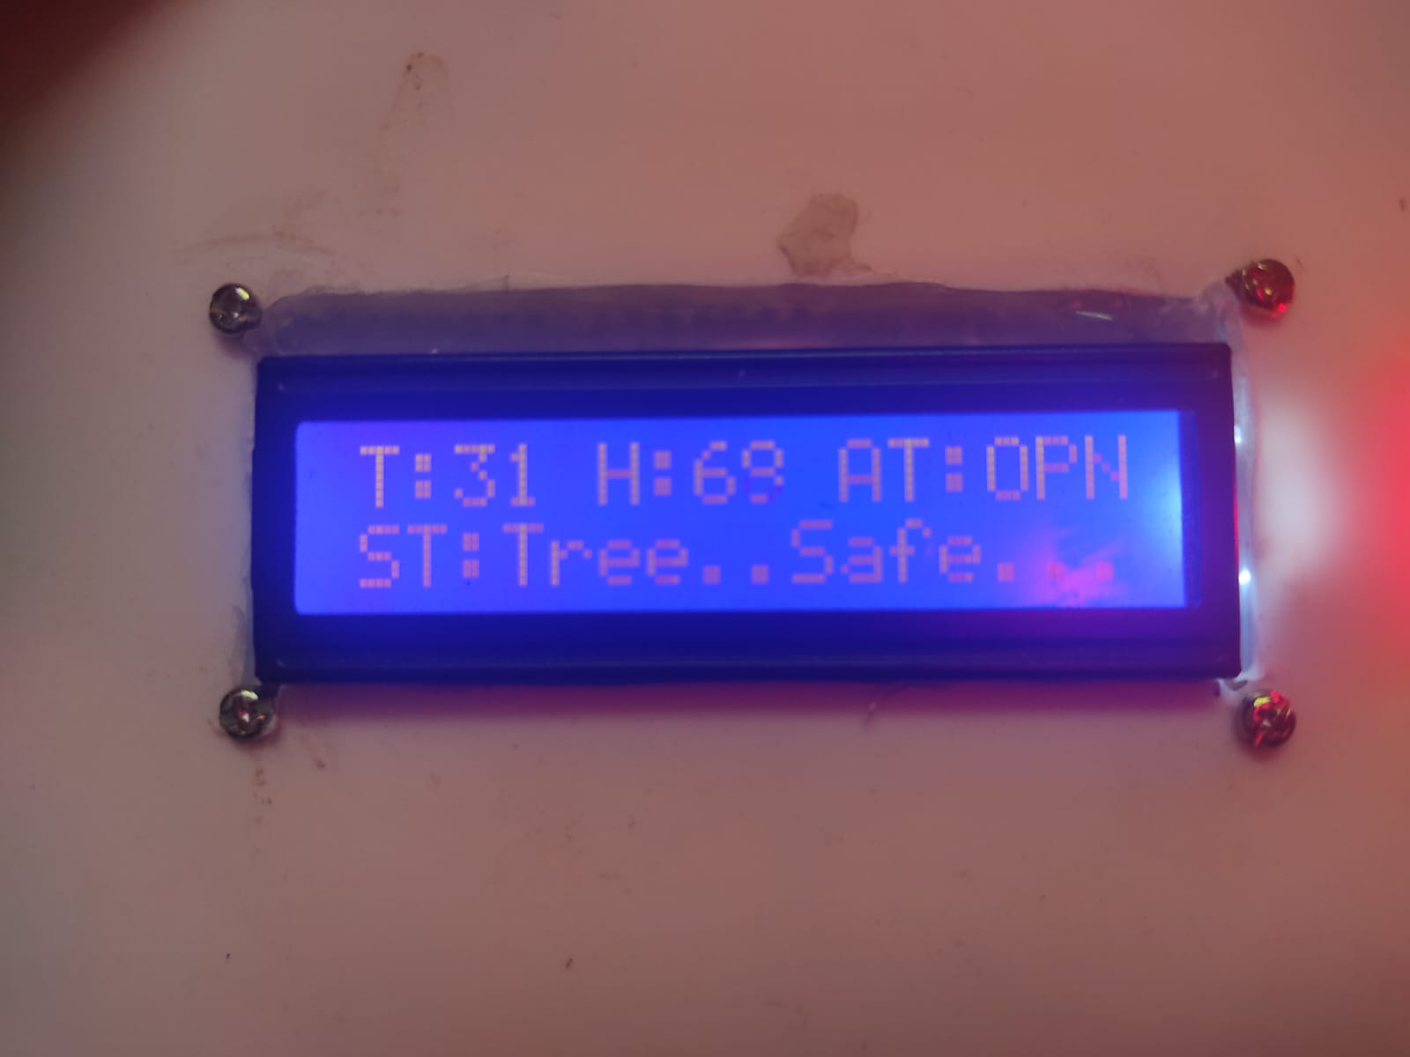
BOX THEFT:
Fig 6 : Alert for Tree theft

Slide 22
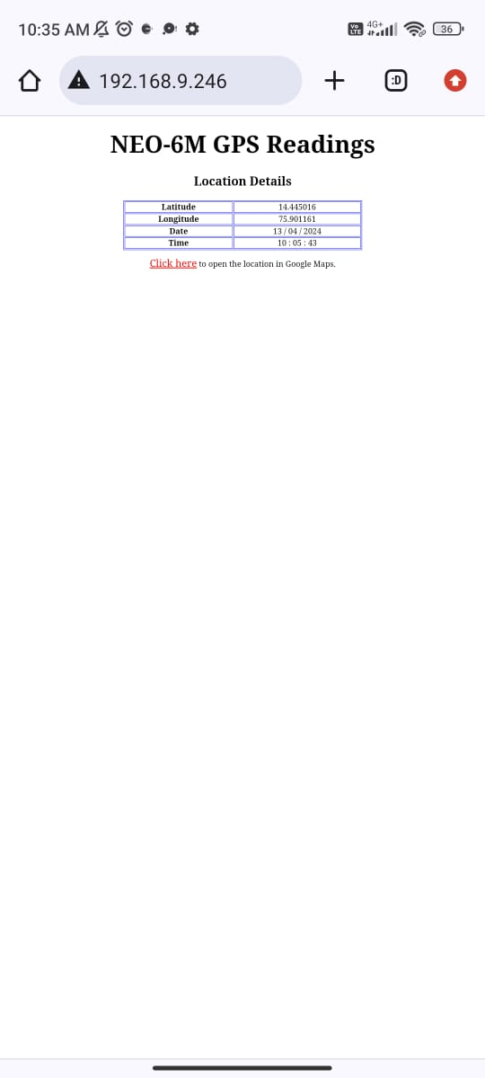
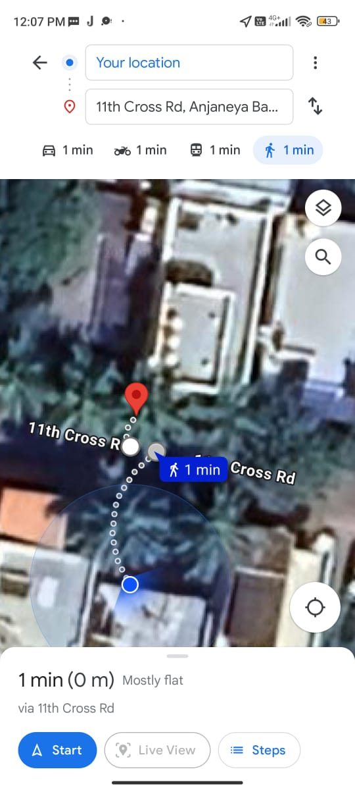
GPS LOCATION
Fig 7 : GPS Location

Slide 23
CONCLUSION
In conclusion, the imperative task of anti-poaching measures aimed at preserving endangered trees is undeniably crucial in safeguarding rampant illegal trade and exploitation of these invaluable species pose a grave threat to the delicate equilibrium of our ecosystems. Halting the ensnarement of these extinct trees through dedicated anti-poaching efforts not only protects the flora itself but also contributes to the sustenance of countless interconnected life forms. By bolstering anti-poaching initiatives, we not only defend endangered trees but also fortify the foundation of a healthier and more sustainable environment, fostering a legacy of responsible stewardship for the natural world. The collective commitment to curbing illegal activities surrounding these precious trees is an investment in the longevity and vitality of our global ecosystem.

Slide 24
FUTURE SCOPE
Although the design was successful there are improvements that could be made in future adaptations of this project. The future scope of this work is:
To develop our own mobile application instead of Blynk application due to its limitations.
To implement automatic water sprinkler to the trees whenever the humidity level is very low or the temperature is very high.

Slide 25
REFERENCES
1. The Author A.Kulkarni et.al. “Wireless Sensor Network (WSN) for protection high cost trees in remote jungles from fire and poaching”, International Seminar on Sandalwood: Current Trends and Future Prospects,2022.
2. The Author S.Veerasingam et.al. “Design of Wireless Sensor Network node on Zigbee for Temperature Monitoring” International Conference on Advances in Computing, Control and Telecommunication Technologies,2022.
3. The author M.Upadhye et.al “Real-Time Wireless Vibration Monitoring System Using LabVIEW” 2022, International conference on Intelligent Computing.
4. The author H.Hamza et.al "Trees Theft Control system",2020 Texas Instruments India Educators' conference (TIIEC),India.
5. The author N.Shilpa et.al "IOT Based Anti-poaching of Trees", International Journal of Engineering and Advanced Technology (IJEAT), ISSN : 2249-8958, volume-8 Issue-5, June 2019, India.

Slide 26
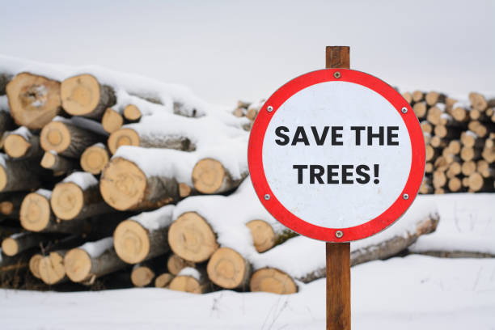
THANK YOU

